Slide 1
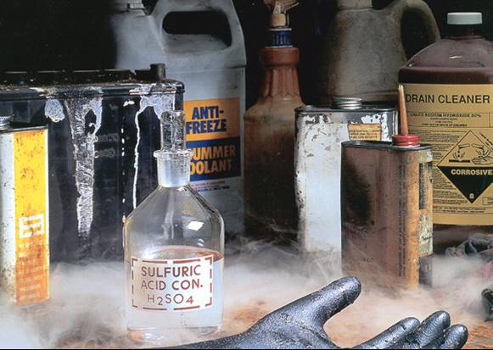
HAZARD COMMUNICATION STANDARD
OSHA 29 CFR 1910.1200
Notes:
More than 30 million workers are potentially exposed to one or more chemical hazards on a daily basis. Exposure to hazardous chemicals is one of the most serious threats facing American workers today. There are an estimated 650,000 existing hazardous chemical products and hundreds of new ones being introduced annually.
Chemical exposure may cause or contribute to many serious health effects such as heart ailments, central nervous system damage, kidney and lung damage, cancer, burns and rashes.
Some chemicals may also be safety hazards and have the potential to cause fires, explosions or other serious accidents.

Slide 2
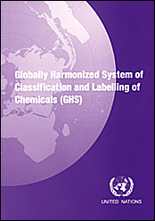
Hazard Communication Standard
First adopted in 1983. Its purpose is to ensure chemical safety in the workplace. In order to do so, information about the identities and hazards of the chemical must be available and understandable to workers.
The HazCom standard (29 CFR 1910.1200) was last revised in March 2012 to improve the quality and consistency of hazard information. It’s now aligned with the United Nation’s Globally Harmonized System of Classification and Labeling of Chemicals (GHS).
Notes:
The Occupational Safety and Health Administration’s (OSHA’s) Hazard Communication Standard (HazCom) was first adopted in 1983. Its purpose is to ensure chemical safety in the workplace. In order to do so, information about the identities and hazards of the chemical must be available and understandable to workers.
The HazCom standard (29 CFR 1910.1200) was last revised in March 2012 to improve the quality and consistency of hazard information. It’s now aligned with the United Nation’s Globally Harmonized System of Classification and Labeling of Chemicals (GHS). GHS has been adopted or is in the process of being adopted worldwide. Each country has their own version so you may see slight differences in classification of materials.
The revised HazCom standard provides a more common and comprehensible approach to classifying chemicals and communicating hazard information on labels and safety data sheets (SDSs).

Slide 3
Most Frequently Cited Serious Violations in General Industry 2016
Hazard Communication – Written Program
Machine Guards – General
Hazard Communication – Information and Training
Overall 1910 MFC
Lockout/Tagout – Developed Procedures
Powered Industrial Trucks – Competency Training
29 CFR 1910 Subparts
Respirators – Medical Evaluations
Machine Guards – Point of Operations
Respirators – Employer establishing a written respirator program
Eye & Body flushing facilities
Hazardous Communication – Maintain copies of SDS’s
Notes:
As you can tell by the bar graph, 3 out of the top 10 are under Hazard Communicaton.

Slide 4
Written Program
SUBPART Z
Information and Training
SDSs Readily Accessible
SDSs for Each Chemical
Hazard Communication – Detailed Training
Notes:
It is easy for inspectors to observe violations
Help to save lives when people know what they are working with

Slide 5
OSHA’s GHS Approach
(Globally Harmonized System)
Terminology better defined
  Hazard classification (reversed)
Consistent SDS format
Labels have more specific requirements
  3 required elements when being shipped or received
  Use of signal words
    DANGER (more severe hazards)
    WARNING (less severe hazards, caution still required)
Notes:
In 2012 OSHA adopted GHS and companies had until 2015 until comply with the standard. This is supposed to help speak a common language.
The hazard category numbering scheme used by OSHA in SDS’s to classify health and physical hazards ranges from 1 to 5, similar to NFPA and HMIS. However, OSHA's use of the 1 to 4 rating system is different from NFPA and HMIS, in that 1 represents a high hazard and 5 represents a low hazard. These hazard category numbers are used primarily on the SDS’s, and are not seen on product or package labeling.

Slide 6

Think of a tree, any kind?
Notes:
How many of yours matched mine? Why? It's because of human nature. As humans, we tend to conform to what is common and what is easy. Your employees will be doing the same. You cannot rely on common sense when it comes to working with chemicals. Some people just don’t truly understand the hazard. It is our responsibility as the employer to train them on recognizing.

Slide 7
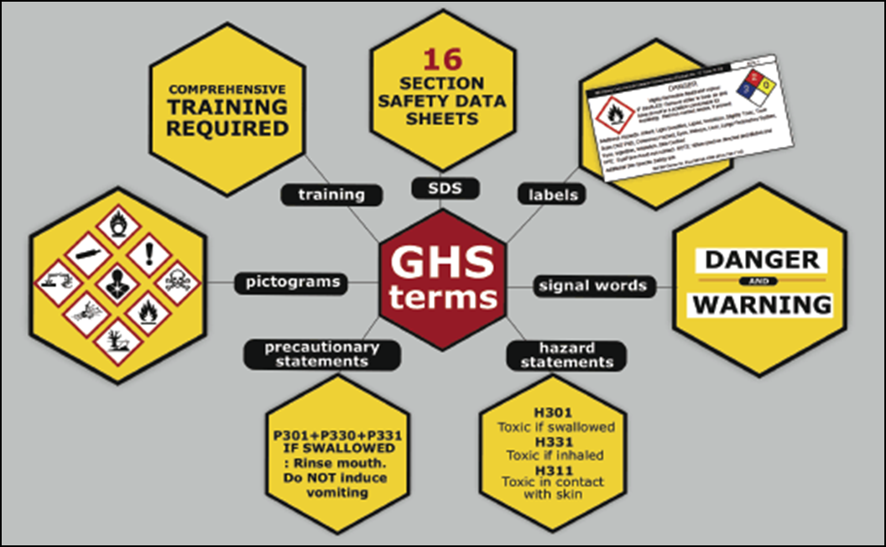
Seven major elements in the GHS-aligned Hazard Communication Standard
Notes:
There are five major provisions of the Hazard Communication Standard with which employers must comply. They are:
Chemical Inventory - A list of the hazardous chemicals in the workplace.
(Material) Safety Data Sheets, or SDS for short, must be available for each hazardous chemical with which you work. SDSs are documents which give very detailed hazard information for a particular chemical
Labeling - Labels must be affixed to each chemical container in the workplace, identify the container contents, and warn the user of any hazards that may exist while using the chemical.
Training - Employers must inform their employees of the hazards of chemicals in their workplace, and train them on how to work safely with those chemicals.
Written Program - There must be a written hazard communication program (on document lookup), or policy, in the workplace which details how the employer complies with the provisions of the Hazard Communication Standard.

Slide 8
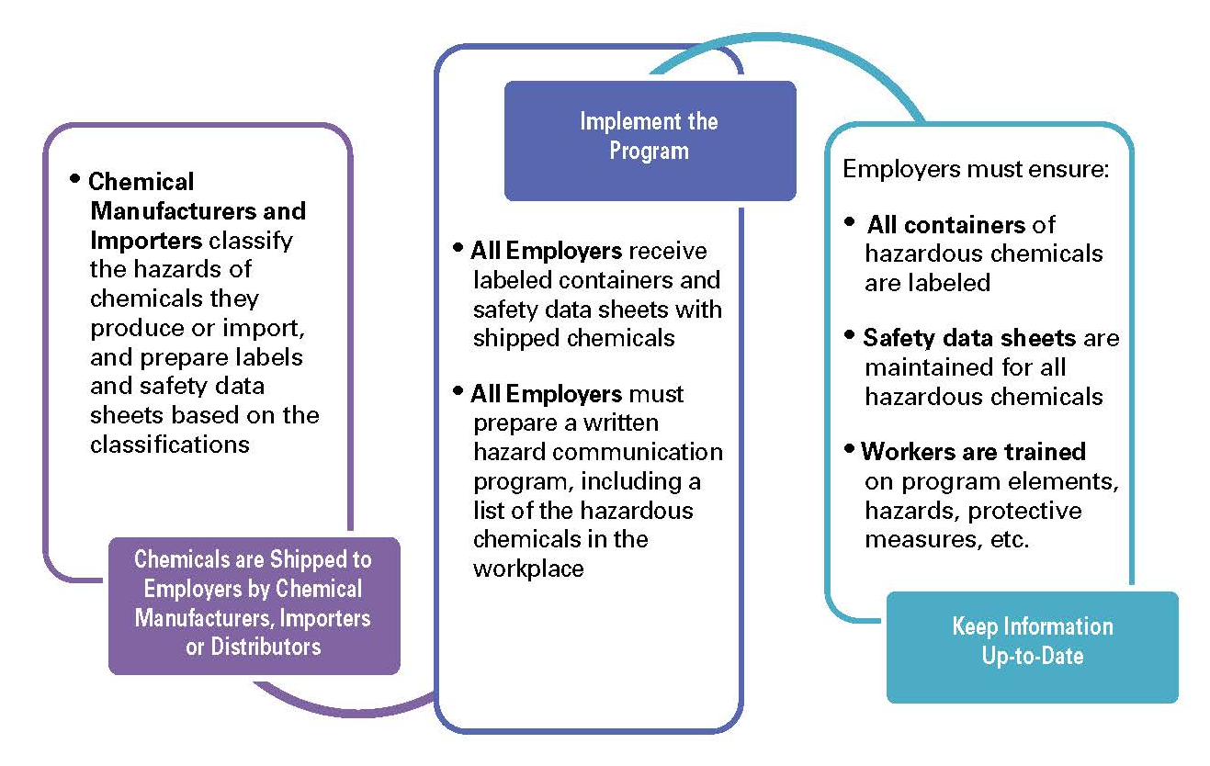
Employer Responsibility: works

Slide 9
Written Program Requirements:
Develop, implement and maintain
Lists of chemicals present
Availability of SDSs
Labeling of containers
Training, training, training (not required annually)
Notes:
List of hazardous chemicals known to be present in the workplace:
List may be kept by product identifier from SDS; may be listed by product name, common name, or chemical name;
Important: name used must be the same as term used on SDS and label for cross-referencing.
“the HCS covers chemicals in all forms---liquids, solids, gases, vapors, fumes, and mists---whether they are “contained” or not. The nature of the chemical and the potential for exposure are the factors that determine whether a chemical is covered.” (pgs. 11-12)
“Identify chemicals in containers, including pipes, but also think about chemicals that are generated during work operations. For example, welding fumes, dusts, and exhaust fumes are all sources of chemical exposures.” (pg. 12)
For use in other program elements, as you survey workplace for hazardous chemicals, you may want to make note their locations and indicate hazards found on labels.

Slide 10

Hazard Communication Standard
The Hazard Communication Standard covers both physical hazards (such as flammability or the potential for explosions) and health hazards (including both acute and chronic effects). By making information available to employers and employees about these hazards and recommended precautions for safe chemical use, illnesses and injuries caused by chemicals can be reduced.

Slide 11

Understanding the Numbers…
for Flammability
OSHA
GHS Nomenclature
Cat 1 = Severe Hazard
Cat 2 = Serious Hazard
Cat 3 = Moderate Hazard
Cat 4 = Slight Hazard
NFPA
4 = Severe
3 = Serious
2 = Moderate
1 = Slight
0 = Minimal
Flammability Criteria | GHS Category | NFPA Rating
FP <73F, BP <100F | 1 or 2 | 4
FP <73, BP >100F FP>73, BP<100F | 2 or 3 | 3
FP>100F, <200F | 3 or 4 | 2
FP>200F | None | 1
OSHA now considers flammable to be at a flashpoint at or below 199.4°F
Notes:
OSHA now considers flammable to be at a flashpoint at or below 199.4°F

Slide 12
Physical Hazards
Physical hazard means there is scientifically valid evidence that the chemical has the potential for one of the following hazardous effects:
Explosion
Flammability
Corrosive to metal
Gas under pressure
Organic peroxide
Oxidizer
Pyrophoric
Unstable (self-reactive)
Water-reactive
Notes:
One type of physical hazard is fire. If you see this fire symbol on a chemical container, it means the product can catch on fire and burn easily. Therefore, it is very important to avoid sources of ignition such as sparks and open flames when working with them.
Flammables have a flashpoint <199.4 degrees Fahrenheit. Note: OSHA has expanded the flammables definition when they revised the HazCom standard in 2012. They also removed the use of the term combustible. Flashpoint- minimum temperature at which liquid gives off enough vapor within a test vessel in sufficient concentration to form an ignitable mixture.
Some chemicals are hazardous because of their ability to rapidly release large amounts of energy.
For example, this symbol identifies a material that is an explosion hazard. Explosive materials can suddenly, almost instantaneously, release pressure, gas and heat when subjected to sudden shock, pressure or high temperature.
Other materials may become dangerous when mixed with water, air or other chemicals. These are classified as reactives. One type of reactive material is water reactive, which reacts with water to release a gas that is either flammable or toxic.
Another type of reactive is an unstable reactive, which is a chemical that can become self-reactive under conditions of shock, pressure or temperature.
Oxidizers
Oxidizers are agents which can promote or initiate combustion in other materials, and will be labeled with this symbol. Oxidizers act either by causing the fire itself, or by releasing oxygen or other gases which make a fire more likely.
Organic peroxide is a type of oxidizer that is widely used in the chemical industry because of its reactive properties.

Slide 13



Health Hazards
A chemical is a health hazard if exposure can cause illness or other health problems. The following is a brief description of the major types of health hazards.
  Corrosives - cause tissue damage and burns on contact with the skin and eyes.
  Irritants - cause intense redness or swelling of the skin or eyes on contact, but with no permanent tissue damage.
  Sensitizers - cause an allergic skin or respiratory reaction.
  Acutely Toxic Materials - cause an adverse effect, even at very low doses.
  Carcinogens - may cause cancer.
  Teratogens - may cause birth defects.
  Organ Specific Hazards - may cause damage to specific organ systems, such as the blood, liver, lungs, or reproductive system.
Notes:
Acute Health Hazards are those whose effects occur immediately or soon after you come in contact with them.
For example, you accidentally spill a strong acid on your hand. The acid will begin to burn your hand immediately. Or, you begin to work with a paint solvent in a closed area, and the fumes make you feel dizzy
Chronic Health Hazards, on the other hand, are those whose effects take years or decades to occur after many exposures.
An example of a chronic health hazard would be asbestos. The dangerous effects for people who have been overexposed to asbestos take years to appear and have been linked to a number of fatal lung diseases

Slide 14
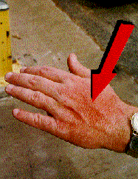

Routes of Exposure
To become harmful, a chemical must first enter or come in contact with your body (called "exposure"). For example, depending on the chemical and the manner in which it is handled, it may enter through different routes:
  your lungs if you breath in fumes, mists or dust (inhalation)
  your skin if liquid or dust touches or spills on you (dermal)
  your mouth if you eat after handling chemicals, or if you accidentally swallow a chemical (ingestion)
Notes:
The LUNGS (Inhalation) are the most common route of exposure for most health hazards. This includes breathing in dust, fumes, oil mist, and vapors from solvents and various gases.
SKIN (Dermal) -- Some chemicals are absorbed into the body through skin contact and cause toxic or whole-body effects.
If a chemical is readily absorbed into the skin, then the notation "(s) – skin exposure" will appear in the occupational exposure guidelines on the SDS.
Some chemicals are not absorbed through the skin, but can still cause health effects such as irritation or chemical burns.
Corrosive chemicals can cause burns and tissue destruction. Extra care must be taken to prevent skin and eye contact with these chemicals. This is why wearing aprons, gloves, eye and face protection, and other protective clothing is important when working with some chemicals.
Washing your hands after potential contact with chemicals (before eating, using the bathroom, etc.) can also reduce any exposure to chemicals.
MOUTH (Ingestion) It is possible to accidentally eat chemicals that are health hazards. To ensure that you do not accidentally eat any of the chemicals you work with:
Never eat or drink in areas where chemicals are used.
Never smoke in areas where chemicals are used.
Wash your hands and face with soap and water after working with chemicals before you eat, drink or smoke

Slide 15
Example-DHMO
Death due to accidental inhalation, even in small quantities
Major component of acid rain
Leads to corrosion and oxidation of many metals
Can contaminate electrical systems
When mixed with a number of hazardous chemicals it can give off poisonous compounds
Notes:
Here is a label scenario: You see a container with DHMO do you know what it is? How do I handle it?
Here are some hazards associated with the materials per SDS-click slide
Holy crap what am I dealing with?
Can anyone guess now?
Dihydrogen Monoxide's chemical formula is H₂0, CAS # 7732-18-5, or better known as water

Slide 16

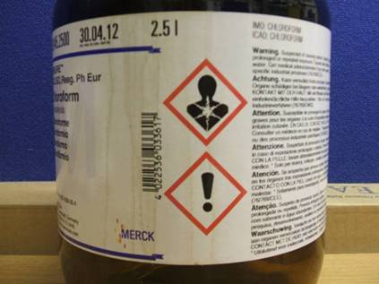
Chemical Labeling
Your first line of defense in protecting yourself against hazardous chemicals is knowledge of the chemical itself. All chemical containers in your workplace must have a proper label, which identifies the chemical and gives some information about its hazards.
Notes:
Signs are there to give you a warning. Your job is to know what they mean. If you are not sure STOP. It is not rocket science but ignoring them can bring harm.

Slide 17

Types of labels:
GHS shipping labels
HCS workplace labels
NFPA 704 labels
HMIS labels
DOT shipping labels, placarding, and markings
Notes:
Shows all the different label types and how it can make you head spin and want to pull out your hair. You are a safety person and understand but thing of an employee that is not used to it. You can assume they know.
When it leaves the plant it has to have GHS and DOT markings.

Slide 18
What's On A Label?
All chemical manufacturers are required to label their products properly. Labels on all chemical containers leaving the workplace must supply the following information:
Product identifier: Must match SDS
Signal word: Danger or Warning
Hazard Statement: describes the nature of the hazard of a chemical. For example, ‘may produce an allergic reaction’ or ‘may form explosive peroxides’.
Precautionary Statement: describes the recommended measures that should be taken to minimize or prevent harmful effect resulting from exposure to the chemical or improper storage or handling.
Pictogram: graphic symbols that convey the health, physical and environmental hazard of the chemical.
Contact Information: name, address and telephone number of the chemical manufacturer, importer or other responsible party.
Notes:
Product identifier: how the chemical is identified (chemical name, trade name, etc...).
Signal word: used to emphasize hazards and indicate the relative level of severity of the hazard. For example “Danger” or “Warning”. Only one signal word corresponding to the most severe hazard will be used on a label. “Danger” indicates a more severe hazard than “Warning”.
Hazard Statement: describes the nature of the hazard of a chemical. For example, ‘may produce an allergic reaction’ or ‘may form explosive peroxides’.
Precautionary Statement: describes the recommended measures that should be taken to minimize or prevent harmful effect resulting from exposure to the chemical or improper storage or handling. For example, ‘avoid breathing dust, fumes, gas, mist vapors or spray’.
Pictogram: graphic symbols that convey the health, physical and environmental hazard of the chemical.
Contact Information: name, address and telephone number of the chemical manufacturer, importer or other responsible party.

Slide 19
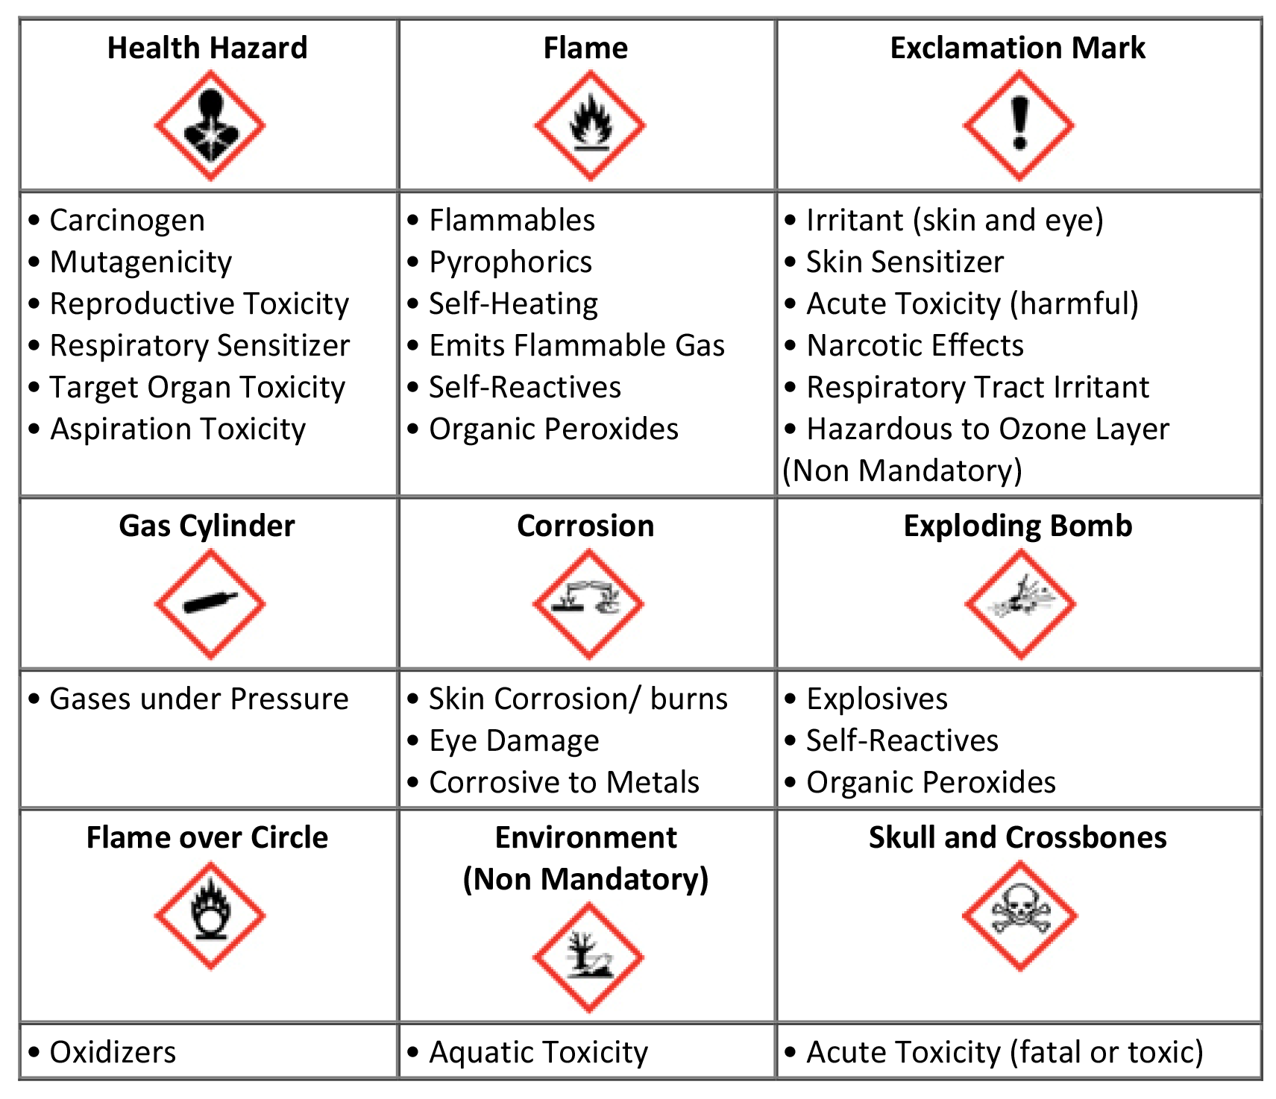
Chemical Labeling
The pictograms consist of a red square frame set at a point with a black hazard symbol on a white background. Each pictogram represents the health, physical or environmental hazard of the chemical. It's very common to see more than one pictogram for a chemical.

Slide 20
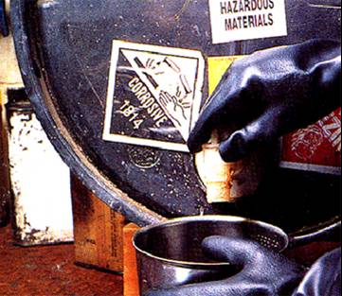
Container Labeling in the Workplace
Within the workplace, the hazard warning on chemical labels can be any type of message, picture or symbol that provides information on the hazards of the chemical(s) and the target organs affected. However, they must not conflict with the hazard warnings or pictograms provided under the OSHA HazCom standard.
Labels must be:
legible
in the local language(s)
prominently displayed
Notes:
In the workplace, in-plant labeling systems can continue to be used as long as the system, in conjunction with other information immediately available to the employee, provides employees with information on all of the health and physical hazards of the chemical. These systems include the use of the National Fire Protection Association (NFPA) diamond and the Hazardous Materials Identification System (HMIS). Other examples of alternative workplace labeling systems are below.
Signs or placards that convey hazard information can be used.
For stationary process equipment, batch sheets, process sheets, operating procedures and similar written materials may be substituted for container labels as long as they identify the containers to which it applies and conveys general information regarding the hazards of the chemical (e.g., product identifier, pictures, symbols or combination).

Slide 21
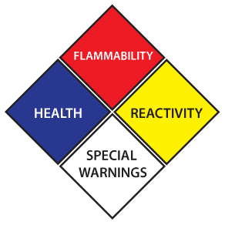
Container Labeling in the Workplace
National Fire Protection Association (NFPA) ratings are not intended to address normal occupational exposures, chronic hazards or carcinogens. Each colored diamond represents a different class of hazard. The hazard classes found on NFPA labels include:
  Health (Blue)
  Flammability (Red)
  Reactivity (Yellow)
  Special Hazards (White)
Each hazard class uses a different color and a rating scale from 0 - 4. The higher the number on the rating scale, the more dangerous the substance.
NOTE: the NFPA numbering scheme is opposite of what is used to classify hazards in the OSHA HazCom standard.
Notes:
The National Fire Protection Association (NFPA) has developed a standard system for indicating the health, flammability, and reactivity hazards of chemicals. In addition, a special precaution symbol may be used when necessary.
This system of identifying hazards associated with various materials was developed primarily for fire protection and emergency personnel but can be useful to anyone who needs to handle potentially hazardous material. As stated in NFPA 704, "This standard provides a simple system of readily recognizable and easily understood markings, which will give at a glance a general idea of the inherent hazards of any material and the order of severity of these hazards as they relate to emergency response." NFPA 704 addresses the health, flammability, instability, and related hazards that are presented by short-term, acute exposure to a material under conditions of fire, spill, or similar emergencies

Slide 22
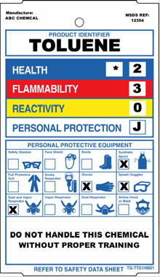
Container Labeling in the Workplace
HMIS which stands for Hazardous Materials Identification System. Originally developed by the National Paint & Coatings Association (NPCA), now known as the American Coatings Association
In addition to the hazard warnings, personal protective equipment information is supplied to give employees information needed to protect themselves from hazardous materials they might encounter on the job.
HMIS and NFPA are similar, but not identical.
HMIS attempts to convey health warning information to employees, while NFPA is meant primarily for fire fighters and other emergency responders.
Notes:
Another workplace labeling system commonly in use is HMIS which stands for Hazardous Materials Identification System. Originally developed by the National Paint & Coatings Association (NPCA), now known as the American Coatings Association, HMIS is a program that helps employers comply with OSHA's Hazard Communication Standard. Like the NFPA diamond, this system uses a numerical hazard rating system and labels with colored bars to inform workers of chemical hazards in the workplace. HMIS ratings are based on a 0-4 rating scale, with 0 representing minimal hazards or risks, and 4 representing significant hazards or risks.

Slide 23
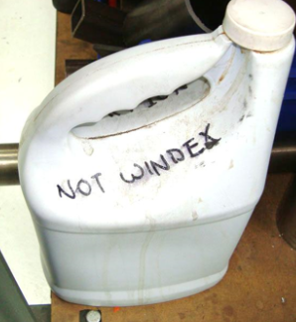
One Labeling Exception
Portable containers are exempt from the labeling requirements of HAZCOM when:
  Portable container for immediate use and the container is completely emptied as a result of the transfer

Slide 24
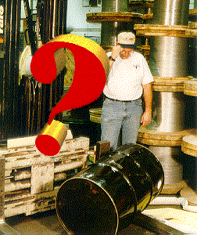
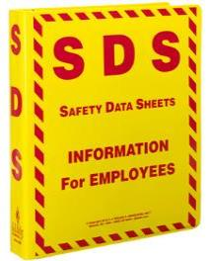
Safety Data Sheets (SDS)
Information Found On SDSs
Safety Data Sheets provide detailed information about a specific hazardous material. It contains a 16-section format.

Slide 25
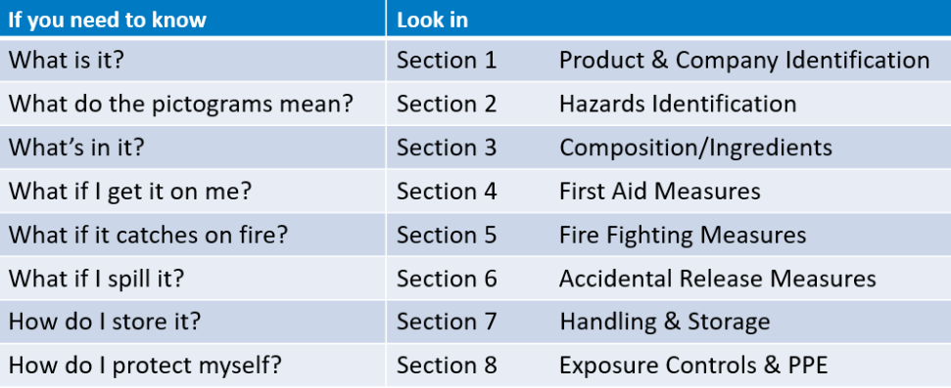
16 Section SDS

Slide 26
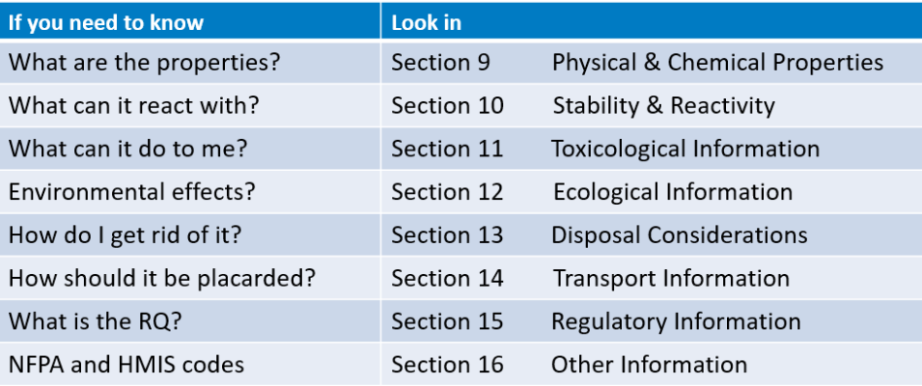
16 Section SDS
Notes:
Section 12 -16 are not required

Slide 27

Detecting Hazardous Chemicals
There are three major ways to detect the presence or release of a hazardous chemical in the workplace:
Observing (primarily using your sense of sight or smell);
Using monitoring devices; and
Recognizing signs or symptoms of overexposure.
Many chemicals can be detected by their appearance - liquid, powder or solid and their color. Chemical odor can also be very distinctive (such as chlorine) and may provide early warning of a release.
Notes:
However, care must be taken not to rely solely on the sense of smell. The odor threshold (the lowest concentration that can be detected by smell) varies greatly from person to person. Also, some chemical exposure limits are below the odor threshold. In this case, if you smell the chemical, you are already being over-exposed. Additionally, some chemicals deaden the sense of smell quickly or after repeated exposures.
The least desirable way to detect the presence of a hazardous chemical in the work area is to experience the signs or symptoms of overexposure. However, it is critical that you are aware of the signs and symptoms of exposure to the chemicals in your area to allow early recognition of a problem. Check the Safety Data Sheets for the chemicals you work with to determine the symptoms and signs to keep in mind.

Slide 28
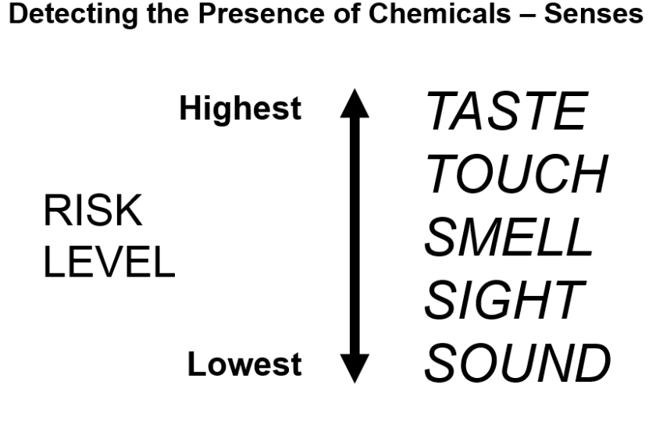

Slide 29

Detecting Hazardous Chemicals
Chemical monitoring instruments are the safest and most reliable way of detecting a hazard chemical in the workplace. The type of instruments used varies with the chemical and the situation.
Area monitoring systems with local alarms (H2S example)
Portable instruments (gas monitors O2, LEL, CO)
Use of gas detector tubes is another way to get a
quick measurement in a specific area
Notes:
In some cases, an area monitoring system will be installed that samples various points in the work area on a periodic or continuous basis. If a chemical level of concern is detected, the instrument will activate warning lights and/or alarms to alert workers of a problem (H2S areas monitors).
More often, portable instruments are used to detect chemicals and determine their concentration in the work area. The instruments may be sensitive to a specific chemical such as oxygen, or they may detect a class of chemicals like combustible gases or hydrocarbons. It is important to understand how the instrument works to understand and properly interpret the readings it provides.

Slide 30
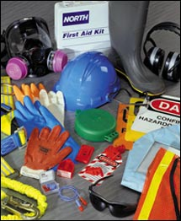
Personal Protective Equipment
Personal Protective Equipment (PPE) may be needed to protect yourself from chemical hazards. Refer to the label or the SDS to determine the appropriate type of PPE to wear.
Examples of PPE include:
Gloves
Goggles
Face shields
Splash aprons
Respirators
Wearing the appropriate PPE can prevent injury.
Notes:
It is so important to perform PPE assessments. Employees need to know if the PPE they are using is the right fit for the job.
Gloves: Gloves protect your hands from chemical exposure. Gloves are available in a variety of materials, such as nitrile, neoprene, and butyl rubber, so choose the right glove for the chemical you are using.
Chemical splash goggles should be worn when there is a risk of splashing chemicals in your eyes.
Face shields must also be worn, along with chemical splash goggles, when working with corrosive chemicals such as strong acids and bases.
Splash aprons protect your body against corrosive chemicals (e.g., material transfers with splash hazard potential).
Respirators may be needed based on potential exposure to vapors, fumes or mists of a hazardous material. If you think you may need a respirator, contact your supervisor or local plant EHS&S representative.

Slide 31
Safe Work Practices
Safe work practices ensure that chemicals are used correctly and safely. Some basic safe work practices are:
  Keep the work area clean and orderly.
  Follow standard operating procedures to the letter. Taking short cuts can greatly increase your risk.
  Use the necessary safety equipment, including the PPE documented on the SDS.
  Carefully label every container with the identity of its contents and appropriate hazard warnings. WHAT LABELS DO YOU REQUIRE AT YOUR FACILITY?
  Proper chemical storage and ventilation can reduce hazard potential.
Notes:
Proper segregation is necessary to prevent incompatible materials from inadvertently coming into contact with each other. If incompatible materials come into contact, fire, explosion, violent reactions or toxic gases may result. When segregating chemicals, acids should not be stored with bases, and oxidizers should not be stored with organic materials or reducing agents. A physical barrier and/or distance is effective for proper segregation.

Slide 32


Company Responsibility
Knowing how to train employees to work safely with chemicals that pose a hazard is an important activity.
Make sure that all chemical containers are properly labeled and employees understand the hazard warnings.
Current Safety Data Sheets for the chemicals in your work area easily available.
Your employees have a right to know, but everyone has a responsibility to use their knowledge and skills to work safely.

